Slide 1

Presentation ​ on​ Skin Lesion Segmentation using​ Deep Learning​ ​ By​ Khushi Patil (70012100165​)
Anannya Londhe (70012100223​)
Pallavi Dangane (70012100227​)
​ Under the Guidance of​: Prof. Pravin Landge Sir​
Information Technology Department
​
MPSTME, Shirpur
​
Academic Year: 2024-25

Slide 2
CONTENTS
Introduction
Problem Statement
Objective
Future Scope
Dataset Used
Block Diagram
Methodologies
Result
Application
Conclusion

Slide 3
Introduction
What is a Skin Lesion?
A skin lesion is an abnormal area of tissue on the skin that may appear different in color, shape, or texture compared to surrounding skin.
Lesions can range from harmless spots, like moles, to dangerous ones, like melanoma, a severe form of skin cancer.
Why Segment Skin Lesions?
Precise segmentation of skin lesions is essential for accurate diagnosis and treatment planning.
It helps in differentiating healthy skin from potentially malignant regions, which is crucial for early detection and intervention.

Slide 4
Problem Statement
Skin cancer rates are increasing globally, with early detection being crucial for effective treatment. Traditional skin lesion segmentation, done manually by dermatologists, is both time-consuming and labor-intensive, introducing risks of inconsistency and human error. These challenges highlight the need for automated solutions that can provide accurate, reliable, and rapid segmentation of skin lesions. This project proposes a deep learning-based approach, aiming to enhance diagnostic accuracy, streamline the segmentation process, and support early detection. This solution has the potential to improve accessibility to high-quality skin cancer diagnostics and positively impact patient outcomes.

Slide 5
Objective
To demonstrate the application of a deep learning-based segmentation model for precise skin lesion segmentation in a real-time laser treatment system, aiming to improve the accuracy, safety, and efficiency of laser-based dermatological procedures. This presentation will explore how the segmented lesion mask can guide laser targeting to selectively treat affected areas while preserving healthy tissue, offering a potential advancement in non-invasive dermatological treatments.

Slide 6
Future Scope
Enhancing Data Diversity: Expanding the dataset to include more annotated images across a wider range of skin tones and lesion types, addressing the limitation of generalization and improving model robustness.
Real-time Capability: Optimizing the model for real-time segmentation, enabling faster and more responsive performance in clinical settings.
Improving Model Usability: Further developing the GUI for user-friendliness, refining it based on practitioner feedback, and testing for streamlined integration into clinical workflows.
Collaboration with Medical Professionals: Expanding collaboration with dermatologists to continuously refine and validate the system's clinical utility, ensuring consistent accuracy and reliability in practical applications.

Slide 7
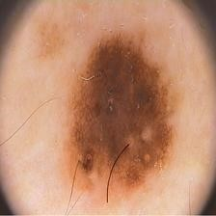
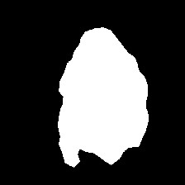
Dataset used
Dataset Used: The PH2 dataset from Kaggle, containing 200 dermoscopic images, is used for deep learning-based skin lesion segmentation
Original Image
Mask Image As Ground Truth

Slide 8
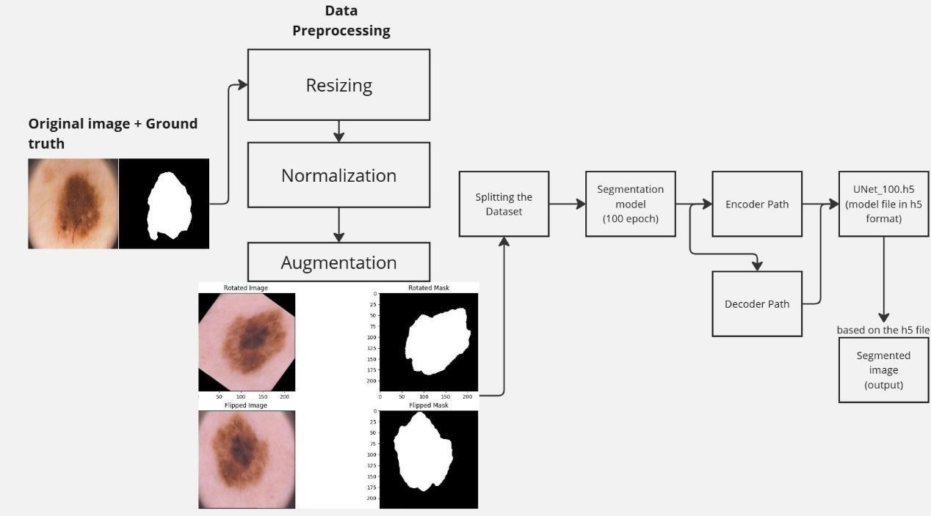
Implementation
Block Diagram

Slide 9
Methodologies
FCN
Input Layer: Accepts RGB images.
Convolutional Layers: Feature extraction with batch normalization, ReLU activation, and MaxPooling.
Dropout Layers: Applied to processing of extracted features.
Decoder: Uses deconvolution prevent overfitting.
Dense Layers: Additional (transposed convolution) and upsampling layers to restore image dimensions.
Output Layer: Sigmoid activation produces the final segmentation mask.
Compilation: Compiled with Adam optimizer and Jaccard distance as the loss function, tracking Dice metrics.
Training: Model and training history saved after training completion.

Slide 10
Result
FCN Algorithm
Metric | Training Set Value
Dice Coefficient | 66.40%
Precision | 58.29%
Recall | 93.90%
Accuracy | 76.56%
1. Training
Metric | Testing Set Value
Dice Coefficient | 20.71%
Precision | 55.99%
Recall | 93.86%
Accuracy | 45.42%
2. Testing
Metric | Validation Set Value
Dice Coefficient | 65.35%
Precision | 55.97%
Recall | 92.21%
Accuracy | 75.00%
3. Validation

Slide 11
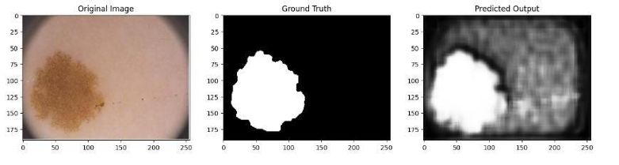
FCN

Slide 12
Methodologies
U-Net
Input/Output: Takes RGB images as input; outputs a single-channel segmentation mask.
Layers: Uses double_conv_layer with ReLU, batch normalization, and spatial dropout to stabilize training.
Architecture: Contracting path (encoder) captures features; expanding path (decoder) restores resolution with skip connections.
Output: 1x1 convolution with sigmoid activation produces a binary mask.
Compilation: Compiled with Adam optimizer, Jaccard distance loss, and tracks Dice metrics.
Training: Trained over multiple epochs; final model saved for segmentation tasks.

Slide 13
Result
U-NET Algorithm
Metric | Training Set Value
Dice Coefficient | 93.08%
Precision | 92.42%
Recall | 93.85%
Accuracy | 95.59%
1. Training
Metric | Training Set Value
Dice Coefficient | 92.37%
Precision | 92.03%
Recall | 92.78%
Accuracy | 95.23%
2. Testing
Metric | Validation Set Value
Dice Coefficient | 88.38%
Precision | 93.98%
Recall | 84.23%
Accuracy | 93.23%
3. Validation

Slide 14
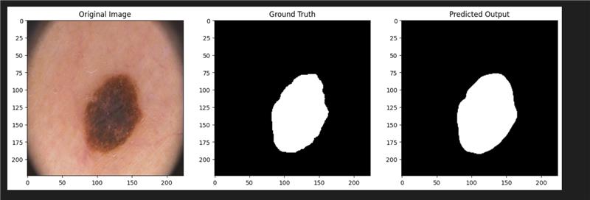
UNET

Slide 15
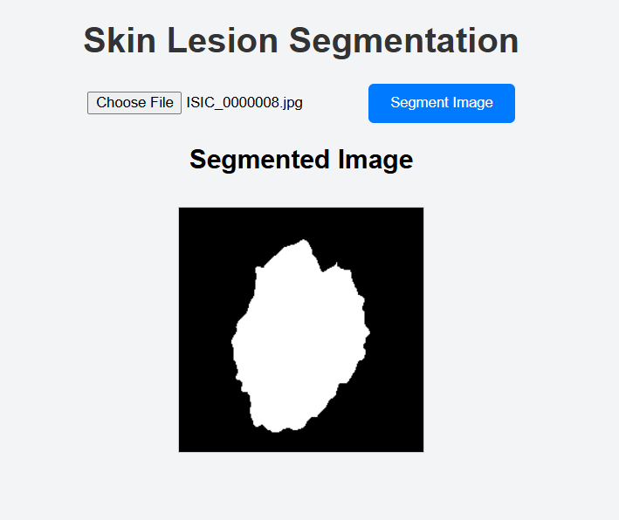
GUI

Slide 16
Application
Early Detection: U-Net and FCN aid in early skin cancer detection by accurately segmenting lesions, supporting timely diagnosis and treatment.
Telemedicine: These models enhance remote diagnosis, allowing dermatologists to assess skin conditions accurately, especially in underserved areas.
Research Advancement: Useful in medical imaging research, fostering the development of more advanced lesion segmentation algorithms.

Slide 17
Conclusion
In this project, U-Net outperformed Fully Convolutional Networks (FCN) for skin lesion segmentation, achieving better results in metrics like Dice Coefficient, and accuracy. U-Net's skip connections enabled it to capture detailed lesion boundaries, while FCN showed more variability, especially on the test set. Data augmentation techniques helped address class imbalance, and specialized loss functions like Dice and Jaccard improved model focus on lesions.

Slide 18
THANK YOU!!
Notes:
Cubism
(Intermediate)
To reproduce the background effects on this slide, do the following:
On the Home tab, in the Slides group, click Layout, and then click Blank.
On the Design tab, in the Background group, click the arrow at the bottom corner to launch the Format Background dialog box.
In the Format Background dialog box, select Fill in the left pane, and under Fill in the right pane, select Gradient fill, then click the arrow to the right of Type and select Linear, and set the Angle to 90 degrees.
Under Gradient stops, click Add gradient stop or Remove gradient stop until two stops appear on the slider. Customize the gradient stops as follows:
Select the first stop on the slider, and then do the following:
In the Position box, enter 0%.
Click the button next to Color, and then under Theme Colors select Blue Accent 1, Darker 25% (fifth row, fifth option from the left).
Select the last stop on the list, and then do the following:
In the Position box, enter 100%.
Click the button next to Color, and then under Theme Colors select Black, Text 1, Lighter 15% (fifth row, second option from the left).
In the Transparency box, enter 20%.
Close the Format Background dialog box.
On the Insert tab, in the Illustrations group, click Shapes, then under Lines, select Line (first row, first option from left).
Press and hold SHIFT, then drag to draw a horizontal line from right-to-left on the slide.
Under Drawing Tools, on the Format tab, in the Size group, click the arrow at the bottom right corner to launch the Format Shape dialog box.
In the Format Shape dialog box, select Size in the left pane, and under Size and rotate in the right pane, set the Height to 0” and the Width to 10”.
Also in the Format Shape dialog box, select Position in the left pane, and under Position on Slide in the right pane, set the Horizontal to 0” and the Vertical to 6.64”.
Also in the Format Shape dialog box, select Line Color in the left pane, and under Line Color in the right pane, select Solid line, then click the arrow to the right of Color and under Theme Colors select, White, Background 1, Darker 25% (fourth row, first option from left), then set the Transparency to 95%.
Also in the Format Shape dialog box, select Line Style in the left pane, and under Line Style in the right pane, set the Width to 2.25 pt.
On the Home tab, in the Clipboard group, click Copy, then select Duplicate. Repeat this step three more times, creating 5 lines total.
Select first duplicated line. In the Format Shape dialog box, select Position in the left pane, and under Position on Slide in the right pane, set the Horizontal to 0” and the Vertical to 4.79”.
Select second duplicated line. In the Format Shape dialog box, select Position in the left pane, and under Position on Slide in the right pane, set the Horizontal to 0” and the Vertical to 3.52”.
Select third duplicated line. In the Format Shape dialog box, select Position in the left pane. Under Position on Slide in the right pane, set the Horizontal to 0” and the Vertical to 2.2”.
Select fourth duplicated line. In the Format Shape dialog box, select Position in the left pane, and under Position on Slide in the right pane, set the Horizontal to 0” and the Vertical to 1”.
Select one of the lines and on the Home tab, in the Clipboard group, click Copy, then select Duplicate.
In the Format Shape dialog box, select Size in the left pane, and under Size and rotate in the right pane, set the Height to 7.5” and the Width to 7.49”.
Also in the Format Shape dialog box, select Position in the left pane, and under Position on Slide in the right pane, set the Horizontal to 1.58” and the Vertical to 0”.
With the Format Shape dialog box still open, on the Home tab, in the Clipboard group, click Copy, then select Duplicate.
In the Format Shape dialog box, select Size in the left pane, and under Size and rotate in the right pane, set the Height to 7.5” and the Width to 7.43”.
Also in the Format Shape dialog box, select Position in the left pane, and under Position on Slide in the right pane, set the Horizontal to 1.3” and the Vertical to 0”.
With the Format Shape dialog box still open, on the Home tab, in the Clipboard group, click Copy, then select Duplicate.
In the Format Shape dialog box, select Size in the left pane, and under Size and rotate in the right pane, set the Height to 6.11” and the Width to 6.08”.
Also in the Format Shape dialog box, select Position in the left pane, and under Position on Slide in the right pane, set the Horizontal to 3.94” and the Vertical to 1.39”.
With the Format Shape dialog box still open, on the Home tab, in the Clipboard group, click Copy, then select Duplicate.
In the Format Shape dialog box, select Size in the left pane, and under Size and rotate in the right pane, set the Height to 6.4” and the Width to 6.41”.
Also in the Format Shape dialog box, select Position in the left pane, and under Position on Slide in the right pane, set the Horizontal to 3.61” and the Vertical to 1.1”.
With the Format Shape dialog box still open, on the Home tab, in the Clipboard group, click Copy, then select Duplicate.
In the Format Shape dialog box, select Size in the left pane, and under Size and rotate in the right pane, set the Height to 4.18” and the Width to 4.17”.
Also in the Format Shape dialog box, select Position in the left pane, and under Position on Slide in the right pane, set the Horizontal to 5.85” and the Vertical to 3.32”.
With the Format Shape dialog box still open, on the Home tab, in the Clipboard group, click Copy, then select Duplicate.
In the Format Shape dialog box, select Size in the left pane, and under Size and rotate in the right pane, set the Height to 3.86” and the Width to 3.85”.
Also in the Format Shape dialog box, select Position in the left pane, and under Position on Slide in the right pane, set the Horizontal to 6.16” and the Vertical to 3.64”.
With the Format Shape dialog box still open, on the Home tab, in the Clipboard group, click Copy, then select Duplicate.
In the Format Shape dialog box, select Size in the left pane, and under Size and rotate in the right pane, set the Height to 1.77” and the Width to 1.91”.
Also in the Format Shape dialog box, select Position in the left pane, and under Position on Slide in the right pane, set the Horizontal to 8.09” and the Vertical to 5.73”.
With the Format Shape dialog box still open, on the Home tab, in the Clipboard group, click Copy, then select Duplicate.
In the Format Shape dialog box, select Size in the left pane, and under Size and rotate in the right pane, set the Height to 1.65” and the Width to 1.73”.
Also in the Format Shape dialog box, select Position in the left pane, and under Position on Slide in the right pane, set the Horizontal to 8.4” and the Vertical to 5.85”.
With the Format Shape dialog box still open, on the Home tab, in the Clipboard group, click Copy, then select Duplicate.
In the Format Shape dialog box, select Size in the left pane, and under Size and rotate in the right pane, set the Height to 6.95” and the Width to 6.94”.
Also in the Format Shape dialog box, select Position in the left pane, and under Position on Slide in the right pane, set the Horizontal to -0.1” and the Vertical to 0”.
With the Format Shape dialog box still open, on the Home tab, in the Clipboard group, click Copy, then select Duplicate.
In the Format Shape dialog box, select Size in the left pane, and under Size and rotate in the right pane, set the Height to 6.64” and the Width to 6.63”.
Also in the Format Shape dialog box, select Position in the left pane, and under Position on Slide in the right pane, set the Horizontal to -0.1” and the Vertical to 0”.
With the Format Shape dialog box still open, on the Home tab, in the Clipboard group, click Copy, then select Duplicate.
In the Format Shape dialog box, select Size in the left pane, and under Size and rotate in the right pane, set the Height to 4.69” and the Width to 4.67”.
Also in the Format Shape dialog box, select Position in the left pane, and under Position on Slide in the right pane, set the Horizontal to -0.1” and the Vertical to 0”.
With the Format Shape dialog box still open, on the Home tab, in the Clipboard group, click Copy, then select Duplicate.
In the Format Shape dialog box, select Size in the left pane, and under Size and rotate in the right pane, set the Height to 4.34” and the Width to 4.33”.
Also in the Format Shape dialog box, select Position in the left pane, and under Position on Slide in the right pane, set the Horizontal to -0.1” and the Vertical to 0”.
With the Format Shape dialog box still open, on the Home tab, in the Clipboard group, click Copy, then select Duplicate.
In the Format Shape dialog box, select Size in the left pane, and under Size and rotate in the right pane, set the Height to 2.2” and the Width to 2.19”.
Also in the Format Shape dialog box, select Position in the left pane, and under Position on Slide in the right pane, set the Horizontal to 0.02” and the Vertical to 0”.
With the Format Shape dialog box still open, on the Home tab, in the Clipboard group, click Copy, then select Duplicate.
In the Format Shape dialog box, select Size in the left pane, and under Size and rotate in the right pane, set the Height to 1.94” and the Width to 1.94”.
Also in the Format Shape dialog box, select Position in the left pane, and under Position on Slide in the right pane, set the Horizontal to 0” and the Vertical to 0”.
Close the Format Shape dialog box.
On the Insert tab, in the Images group, click Picture.
In the left pane of the Insert Picture dialog box, click the drive or library that contains the picture “Cubes.png”. In the right pane of the dialog box, click the picture that you want and then click Insert.
Under Picture Tools, on the Format tab, in the Size group, click the arrow at the bottom corner to launch the Format Picture dialog box.
Select the picture. On the Home tab, in the Drawing group, click Arrange, point to Align, and then do the following:
Click Align Top.
Click Align Center.
In the Format Picture dialog box, select Shadow in the left pane, and under Shadow in the right pane, click the arrow to the right of Presets, and under Perspective, select Perspective Diagonal Upper Right, and then do the following:
In the Transparency box, enter 80%.
In the Size box, enter 95%.
In the Blur box, enter 6 pt.
In the Angle box, enter 359 degrees.
In the Distance box, enter 0 pt.
To reproduce the video effects on this slide, do the following:
On the Insert tab, in the Media group, click Video, and then click Video From File.
In the left pane of the Insert Video dialog box, click the drive or library that contains the video. In the right pane of the dialog box, click the video that you want and then click Insert.
Under Video Tools, on the Format tab, in the Video Styles group, click the arrow to the right of Video Shape, under Basic Shapes, select Cube (second row, eleventh option from left).
Also under Video Tools, on the Format tab, in the Video Styles group, click the arrow at the bottom right corner to launch the Format Video dialog box.
In the Format Video dialog box, select Size in the left pane, and under Scale, clear Lock Aspect Ratio.
Also in the Format Video dialog box, select Size in the left pane, and under Size and rotate in the right pane, set the Height to 3.43” and the Width to 3.93”.
Also in the Format Video dialog box, select Position in the left pane, and under Position on Slide in the right pane, set the Horizontal to 2.23” and the Vertical to 3.64”.
Also in the Format Video dialog box, select Border Color in the left pane, and under Border Color in the right pane, select Gradient Line, and then click the arrow to the right of Type and select Linear.
Under Gradient stops, click Add gradient stop or Remove gradient stop until three stops appear on the slider. Customize the gradient stops as follows:
Select the first stop on the slider, and then do the following:
In the Position box, enter 0%.
Click the button next to Color, and then under Theme Colors select Blue, Accent 1, Lighter 80% (second row, fifth option from the left).
Select the second stop on the list, and then do the following:
In the Position box, enter 50%.
Click the button next to Color, and then under Theme Colors select Blue, Accent 1, Lighter 60% (third row, fifth option from the left).
Select the last stop on the list, and then do the following:
In the Position box, enter 100%.
Click the button next to Color, and then under Theme Colors select Blue, Accent 1, Lighter 40% (fourth row, fifth option from the left).
Also in the Format Video dialog box, select Border Style in the left pane, and under Border Style in the right pane, set the Width to 0.25 pt.
Also in the Format Video dialog box, select Shadow in the left pane, and under Shadow in the right pane, do the following:
In the Transparency box, enter 80%.
In the Size box, enter 100%.
In the Blur box, enter 10 pt.
In the Angle box, enter 192 degrees.
In the Distance box, enter 0 pt.
Close the Format Video dialog box.
On the Animations tab, in the Animation group, click Play, then in the Timing group, click the arrow to the right of Start and select With Previous.

